Slide 1
Cooperative Spectrum Sensing in Cognitive Radio
Project of the Course :
Software Defined Radio
Isfahan University of Technology
Spring 2010
Paria Rezaeinia
Zahra Ashouri

Slide 2
OUTLINE
Introduction
Cognitive Radio Overview
Spectrum Sensing
Energy Detection Method
Cooperative Communication
Cooperative Spectrum Sensing
Cooperative Sensing Methods
Hard Decision Combining
Soft Decision Combining
Soft and Hard Combination method

Slide 3
Introduction
As wireless technologies continue to grow, more and more spectrum resources will be needed.
Within the current spectrum regulatory framework, however, all of the frequency bands are exclusively allocated to specific services.
No violation from unlicensed users is allowed.
A recent survey of spectrum utilization made by the FCC has indicated that the actual licensed spectrum is largely underutilized in vast temporal and geographic dimensions .
The spectrum usage varies significantly in various time, frequency, and geographic locations.
Spectrum utilization can be improved significantly by allowing a secondary user to utilize a licensed band when the primary user (PU) is absent.
So detecting spectrum holes is important in new wireless technologies.

Slide 4
Cognitive Radio Overview
Cognitive radio is a solution to the spectral congestion problem by introducing opportunistic usage of the frequency bands that are not heavily occupied by licensed users.
It will allow the agile and efficient utilization of the radio spectrum by offering distributed terminals or radio cells the ability of radio sensing, self-adaptation, and dynamic spectrum sharing.
Two primary objectives :
Highly reliable communications whenever and wherever needed .
Efficient utilization of the radio spectrum.

Slide 5
Cognitive Radio Overview
In the definition adopted by FCC Cognitive radio is a radio or system that:
Senses its operational electromagnetic environment.
Dynamically and autonomously adjust its radio operating parameters to modify system operation .
Parameters such as:
Transmit power
Carrier frequency
Modulation strategy

Slide 6
CR Functions
Spectrum Sensing
Determine which portions of the spectrum are available and detect the presence of licensed users when a user operates in a licensed band.
Spectrum Management
Select the best available channel.
Spectrum Mobility
Vacate the channel when a licensed user is detected.
Spectrum Sharing
Coordinate access to this channel with other users.

Slide 7
Spectrum Sensing
Spectrum sensing is a key element in CR communications, as it enables the CR to adapt to its environment by detecting spectrum holes.
One of the most important challenges for cognitive radio systems is to identify the presence of primary (licensed) users over a wide range of spectrum at a particular time and specific geographic location.
So spectrum sensing is significant in CRs in avoiding a
collision with the licensed user and improving the licensed
spectrum utilization efficiency.

Slide 8
Spectrum Sensing
Definition
Detection probability : the probability of detecting right primary user.
False alarm probability :probability of deciding on presence of PU when it is absent in fact.

Slide 9
Spectrum Sensing Methods
To enhance the detection probability, many signal detection techniques can be used in spectrum sensing.
Two main categories :
Primary transmitter detection
Interference Temperature Concept

Slide 10
Primary transmitter detection methods
Energy Detection
Wave-form Based Sensing
Radio Identification Based Sensing
Matched Filtering
Other

Slide 11
Energy Detection
If prior knowledge of the PU signal is unknown, the energy detection method is optimal for detecting any signals.
The energy detector scheme incurs a very low computational and implementation cost and complexities and therefore is widely used.
In this approach, the radio-frequency (RF) energy in the channel or the received signal strength indicator is measured to determine whether the channel is idle or not.

Slide 12
ED Disadvantages
It has poor performance under low SNR conditions. This is because the noise variance is not accurately known at the low SNR, and the noise uncertainty may render the energy detection useless.
The threshold used in energy selection depends on the noise variance.
Another challenging issue is the inability to differentiate the interference from other secondary users sharing the same channel and the PU.

Slide 13
Spectrum Sensing Challenges
Hardware Requirements
Hidden Primary User Problem
Detecting Spread Spectrum Primary Users
Sensing Duration and Frequency
Security

Slide 14
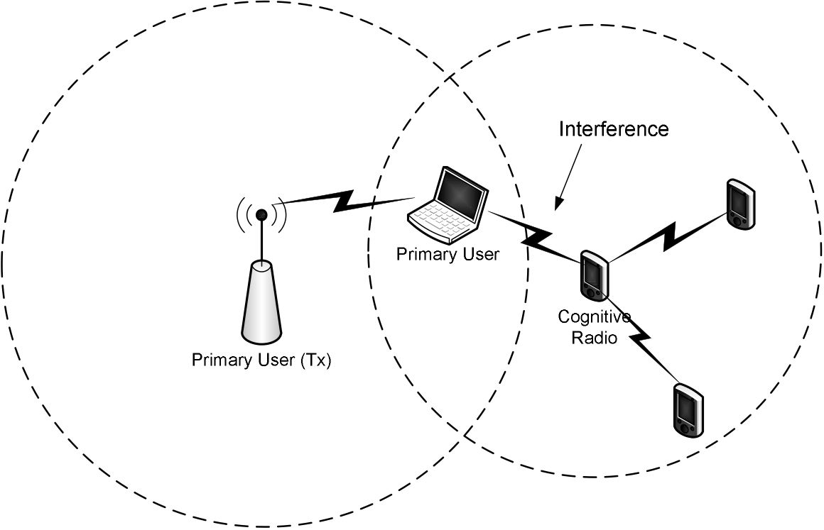
Spectrum Sensing Challenges
Hidden Primary User Problem
Primary transmitter’s signal could not be detected because of the locations of devices . It can be caused by many factors including severe multipath fading or shadowing observed by secondary users.

Slide 15
Cooperative Communications
Cooperative communications allows different users or nodes in a wireless network to share resources and to create collaboration.
Cooperative communication promises significant capacity and gain increase in wireless networks.

Slide 16
Cooperative Communications
It has mainly three protocols:
Amplify & forward (AF)
The received signal is amplified and retransmitted to the destination.
Simple and low cost implementation
Noise is also amplified
Decode & forward (DF)
The relay attempts to decode the received signals. If successful, it re encodes the information and retransmits it.
Compress & forward (CF)
Generate an estimate of the received signal then compressed, encoded, and transmitted in the hope that the estimated value may assist in decoding the original codeword at the destination.

Slide 17
Cooperative Spectrum Sensing
cooperative spectrum sensing is performed as :
Every CR performs its own local spectrum sensing measurements independently and makes a binary decision on whether the PU is present or not.
All of the CRs forward their decisions to a common receiver.
The common receiver fuses the CR decisions and makes a final decision to infer the absence or presence of the PU.

Slide 18
Cooperative Spectrum Sensing
Cooperative spectrum sensing is used to enhance the reliability of detecting PUs:
Decreases the probabilities of miss-detection and false alarm.(e.g. when one CR is far away from the primary user)
Solve hidden primary user problem.
Decrease sensing time.

Slide 19
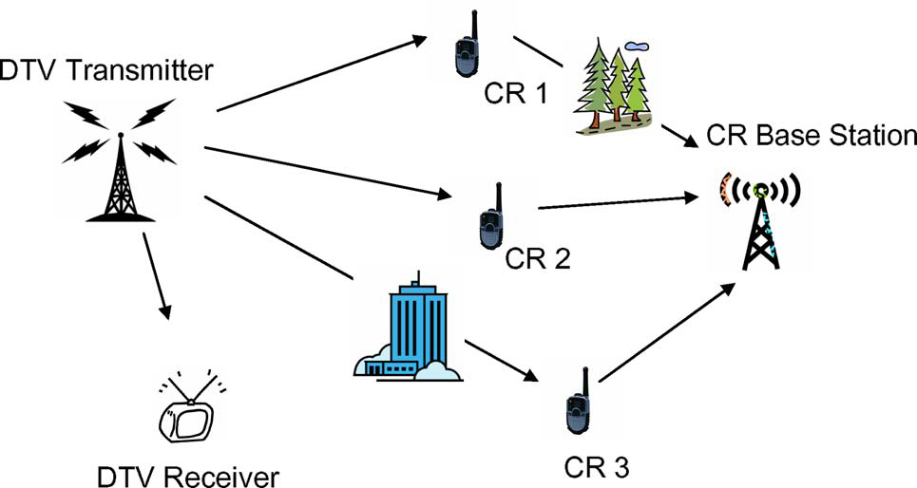
Cooperative Spectrum Sensing

Slide 20
Cooperative Sensing Challenges
Increased complexity
Cooperative spectrum sensing will go through two successive channels: 1) sensing channel (from the PU to CRs) and 2) reporting channel (from the CRs to the common receiver). This will deteriorate the transmission reliability of the sensing results.

Slide 21
Cooperative Sensing Challenges
In a CR network with a large number of CRs, cooperative spectrum sensing may become impractical because in a time slot only one CR should send its local decision to the common receiver so as to separate decisions easily at the receiver end.
Cooperating with all users in the network does not necessarily achieve the optimum performance.
Cognitive users with highest primary user’s signal to noise ratio are chosen for collaboration.
Cooperation can be done with two CRs per cluster while keeping the others isolated.

Slide 22
Methods of Cooperation
External sensing
An external agent performs the sensing and broadcasts the channel occupancy information to CRs.
Collocated sensing Among CRs
Centralized Sensing
Distributed Sensing

Slide 23
Centralized Sensing
A central unit
Collects sensing information from cognitive devices.
Identifies the available spectrum.
Broadcasts this information to other cognitive radios.
Disadvantage
In the case of a large number of users, the bandwidth required for reporting becomes huge.
Solution
Local observations of cognitive radios are quantized to one bit to reduce the sharing bandwidth.
Only the cognitive radios with reliable information are allowed to report their decisions to the central unit (Censoring).

Slide 24
Distributed Sensing
In this case, cognitive nodes share information among each other and make their own decisions as to which part of the spectrum they can use.
To minimize the network overhead due to collaboration only final decisions are shared .
Advantage
There is no need for a backbone infrastructure it has reduced cost.

Slide 25
External Sensing
External sensing algorithms solve some problems associated with the internal sensing:
Overcoming hidden primary user problem.
Spectrum efficiency is increased as the cognitive radios do not spend time for sensing.
Power consumption problem of internal sensing is solved since the sensing network does not need to be mobile and not necessarily powered by batteries.

Slide 26
Cooperative Spectrum Sensing(soft-hard)
Hard :
Each node decides on the presence or absence of the primary user and sends its decision to central unit or other nodes.
One advantage of this method is the easiness and that it needs less bandwidth.

Slide 27
Cooperative Spectrum Sensing(soft-hard)
Soft :
The node does not decide and just sends its observations to central unit or other nodes.
Although this method consume more bandwidth but it works better than hard methods.

Slide 28
Hard Methods
OR
AND
M out of N
Other methods
Censor
……

Slide 29
OR
In this method even if just one node detects the primary user’s signal, the whole system decides that the primary user is present.
In the simulation result the we assume that the method is centralized and each node’s detector is energy detector.

Slide 30
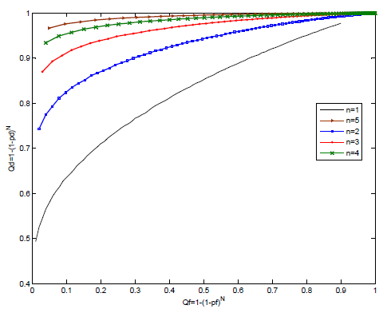
OR

Slide 31
OR
From the simulation it is clear that when the number of the nodes increases, probability of detection will increase too.
The probability of detection and false alarm in this method are:

Slide 32
AND
When this method is applied the whole cognitive system will consider the primary user present, if all of the nodes can detect it.

Slide 33
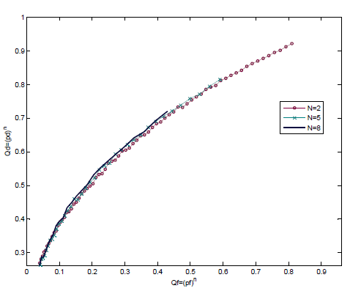
AND

Slide 34
AND
As it can be seen in the simulation in this method the system’s efficiency does not change a lot when the number of the nodes changes.
The probability of detection and false alarm in this method are:

Slide 35
M out of N
This method will help the system designer to decide on the number of the nodes which will cause the system to consider the primary user present.

Slide 36
Majority
A kind of M out of N method in which the number of M is equal to [N/2]+1
While the number of M changes with the changes in the number of N, this method works better than the simple M out of N.

Slide 37
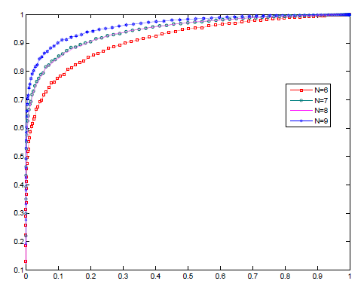
M out of N

Slide 38
M out of N
This method works on both probabilities and both probability of detection and probability of false alarm can be improved in this method.
Probability of detection and false alarm are :

Slide 39
Compare
Each of hard methods discussed above have some advantages and some disadvantages.
The OR method improves the probability of detection but in other hand it increases the probability of false alarm too.

Slide 40
Compare
The AND method decreases the probability of false alarm but it also decreases the probability of detection.
In the M out of N method the number of M can be chosen in a way that both probabilities will stay in an accepted domain.

Slide 41
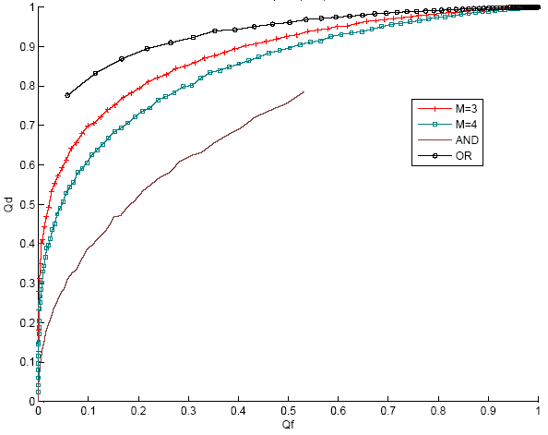
Compare

Slide 42
Other
There are some other methods that try to make spectrum usage more efficient.
As it is clear the cooperative method make the estimations more reliable but it also consume more bandwidth.
Methods like censoring are recommended to lessen the bandwidth usage.

Slide 43
Censor
In censoring method each node will decide using two thresholds and if the detection energy is between thresholds the node will sent nothing to the central unit.
Depends on the number of the nodes that do not send bits to the central unit the spectrum utilization will reduce.

Slide 44
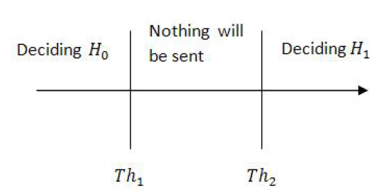
Censor
: no signal detected
: primary user’s signal detected

Slide 45
Soft Decision Combining
Equal Gain Combining
Maximal Gain Combining

Slide 46
Equal Gain Combining
It is one of the simplest soft methods.
In this method the estimated energy in each node is sent to the base station and there they will be added together. Then this summation is compared to a threshold to decide on the existence or absence of the primary user.

Slide 47
Maximal Gain Combining
The difference between this method and equal gain combining is that in this method the energy received in the central unit is multiplied to a weight and then added up. This weight depends on the distance from the node and the primary user.

Slide 48
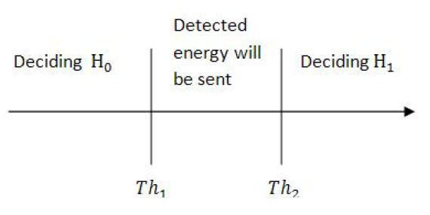
Soft & Hard Combination
The method is just like censoring but when the detection energy is between two thresholds the node will send the energy itself and not the decision.

Slide 49
Soft & Hard Combination
This method uses more bandwidth but it has better efficiency too.
The soft and hard combination method suggests a good tradeoff between performance and complexity.

Slide 50
Conclusion
In cooperative spectrum sensing, several secondary users share their detections and with these detections the decision on the presence or absence of the primary user is made.
Cooperative sensing improves the detection probability.
Cooperative sensing can be in hard or soft methods.

Slide 51
Conclusion
Hard method is easier but soft methods have better efficiency and will improve the detection probability.
There are some methods which are a combination of soft and hard methods.
The softend hard combination method achieves a good tradeoff between performance and complexity.

Slide 52
References
I.F. Akyildiz, W.-Y. Lee, M.C. Vuran, and S. Mohanty. “Next generation/dynamic spectrum access/cognitive radio wireless networks: A survey”. ElsevierComputer Networks, 50:2127–2159, September 2006.
Tevfik Yucek and Huseyin Arslan. "A survey of spectrum sensing algorithms for cognitive radio applications". Communications Surveys & Tutorials, IEEE In Communications Surveys & Tutorials, IEEE, Vol. 11, No. 1. (04 March 2009), pp. 116-130.
Ghasemi, A. and Sousa, E.S., “Opportunistic Spectrum Access in Fading Channels Through Collaborative Sensing”, Journal of Communications, Academy Publisher, Vol. 2, No. 2, pp. 71-82, 2007.
Danijela Cabric,Artem Tkachenko, Robert W. Brodersen, Berkeley Wireless Research Center," Experimental Study of Spectrum Sensing based on Energy Detection and Network Cooperation" 2006.
Jun Ma, Guodong Zhao, and Ye Li, "Soft Combination and Detection for Cooperative Spectrum Sensing in Cognitive Radio Networks", IEEE Transactions on Wireless Communications, Vol.7, November 2008. [1] Chen Guo, Tao Peng, Shaoyi Xu, Haiming Wang, and Wenbo Wang, "Cooperative Spectrum Sensing with Cluster-Based Architecture in Cognitive Radio Networks", IEEE 69th Vehicular Technology Conference, 2009.

Slide 53
References
Shen, B., Kwak, K.S., “Soft Combination Schemes for Cooperative Spectrum Sensing in Cognitive Radio Networks”, ETRI Journal, 2009.
Khaled Ben Letaief , and Wei Zhang “Cooperative Communications for Cognitive Radio Networks”. Vol. 97, No. 5, May 2009 | Proceedings of the IEEE 879
Jiang Zhu, Zhengguang Xu, Furong Wang, Benxiong Huang, Bo Zhang, Department of Electronics and Information Engineering, Huazhong University of Science and Technology,Wu Han, P.R.China ,"Double Threshold Energy Detection of Cooperative Spectrum Sensing in Cognitive Radio" 2009 First International Conference on Information Science and Engineering
Sun, C., Zhang, W., and Letaief, K.B., “Cooperative spectrum sensing for cognitive radios under bandwidth constraints”, IEEE Wireless Communication and Networking Conf., pp. 1–5, Hong Kong, 2007
Chen Guo, Wenbo Wang, Tao Peng,Wireless Signal Processing and Network Lab
Key laboratory of Universal Wireless Communication, Ministry of Education,Beijing University of Posts and Telecommunications,"Agility Improvements by Censor-Based Cooperative Spectrum Sensing in Cognitive Radio Networks" Third International Conference on Communications and Networking in China, 2008.

Slide 54
Any question?

