Slide 1
Challenges To Cognitive OFDM Systems
دانشگاه صنعتي اصفهان
دانشکده برق و کامپيوتر
Advisor:
Dr. M.J. Omidi
عادل آقاجان

Slide 2
Challenges To Cognitive OFDM Systems
• Spectrum sensing
• Cross-layer adaptation
• Interference avoidance
• ...
• intercarrier
Interference(ICI)
• peak-to-average-power
ratio (PAPR)
• Synchronization
• ...
OFDM
challenges
Cognitive radio challenges

Slide 3
Challenges To Cognitive OFDM Systems
Multiband OFDM system design
Location awareness
Signaling the transmission parameters
Synchronization
Mutual interference

Slide 4
Multiband OFDM System Design
total bandwidth is divided into smaller bands
Disadvantage of single-band OFDM (wide band) :
The building of highly complex RF circuitry
High speed analog-to-digital converters
higher complexity channel equalizers
For OFDM-based CR, the question is when to use multiband and when to use single band.
Multiband OFDM is employed in UWB.
The challenges that face the implementation :
wide-range frequency synthesizers
broadband circuits
…

Slide 5
Location Awareness
Applications utilizing location information can be grouped into four categories:
Location-based services
Example: monitoring real-time traffic
location-assisted network optimization
Example: location-assisted dynamic spectrum access systems
location-assisted transceiver algorithm optimization
Example: location-assisted link adaptation
location-assisted environment sensing
Example: location-assisted channel environment identification
Pilot sequences which are commonly used in OFDM systems for synchronization, can be used for tracking of unit locations.

Slide 6
Signaling The Transmission Parameters
Distributing information among communication units, rather than using local sensing:
reduces the complexity
improves the performance of the system
Approach:
Exchange measured information and transmission parameters among cognitive units with usage of licensed channel .
Disadvantage:
As the number of units in the same cell increases, the amount of information that must be distributed increases as well.
The ability of cognitive units to operate adaptively within any given unlicensed band becomes dependent on the availability of such a channel.

Slide 7
Signaling the transmission parameters (cont.)
Other approach:
Sending a vector containing disabled subcarriers rather than by sending the spectrum sensing results.
The deactivation of subcarriers is performed over a block of subcarriers instead of individual subcarriers.
Disadvantage:
Probability of interfering is high

Slide 8
Signaling The Transmission Parameters (cont.)
An Innovative approach:
Tone-boosting:
All the terminals modulate a complex symbol at maximum power on those OFDM subcarriers representing the subbands newly allocated by the licensed system.
All other OFDM subcarriers are modulated with no signal.
If this is carried out simultaneously by all participating terminals, the access point receives a superposition of the original transmit signals of the licensed users and the OFDM signals of the terminals of the rental system :
power amplification of the newly allocated subbands
extremely high detection probabilities

Slide 9
Tone-boosting(cont.)
This signal interfere with licensed system.
But simulation results have shown that only 10 μs is enough to achieve reliable distributed detection.
Plus, only new accesses of licensed users are affected.

Slide 10
Synchronization
Synchronization has a large relevance in an OFDM system as this modulation technique is very sensitive to phase noise, frequency offset and timing errors.
With the introduction of CR, conventional synchronization methods become insufficient.

Slide 11
Synchronization(cont.)
Preamble structure of an IEEE802.11a data packet
It consists of ten short training symbols (sts) and two long training symbols (LTS) separated by a guard interval (GI).
Usage:
signal detection
automatic gain control
carrier sensing
estimation of the frequency
estimation of the clock offsets

Slide 12
Synchronization(cont.)
Problem of synchronization :
The NBI(narrowband interference) can interfere with the preamble.
Preamble can fall into unusable subcarriers.
Solution:
Longer preambles are required in CR-OFDM systems.

Slide 13
Mutual Interference
The side lobes of modulated OFDM subcarriers are known to be large.
Mutual Interference :
Used subcarrier power leaks to nulled subcarriers, which causes interference to LUs.
Solution:
Windowing in time domain(raised cosine window)
Disadvantage:
Reduction of spectral efficiency
Increase the number of nulled subcarriers(neighboring subcarriers)
Disadvantage:
Reduction of spectral efficiency

Slide 14
Mutual Interference(cont.)
Other solution :
Active Interference Cancellation :
Instead of disabling subcarriers adjacent to spectrum holes, a much smaller number of those adjacent subcarriers is used to reduce the interference leaked to spectrum holes.
Disadvantage:
Increase complexity

Slide 15
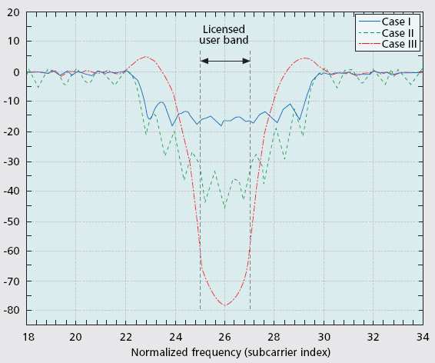
Mutual Interference(cont.)
Case I:
Subcarriers 23 through 29 are disabled.
CP is 8 samples
Spectrum hole with a 15-dB depth
Case II:
Raised cosine window
Roll-off factor of 0.25
Subcarriers 23 through 29 are disabled.
CP is 64 samples(orthogonality)
Spectrum hole with a 30-dB depth
Case III:
Third method
CP is 8 samples
Subcarriers 25 to 27 are disabled
Subcarriers 23, 24, 28, and 29 are used as cancellation subcarriers.
Spectrum hole with a 70-dB depth

Slide 16
Thanks for your attention

