Slide 1
IN THE NAME OF GOD

Slide 2
BEAM-FORMING
Zahra naghsh
July 2009

Slide 3
CONTENT
Introduction
Smart antenna and SDR
Several beam-forming methods
Adaptive beam-forming algorithms
summary

Slide 4
INTRODUCTION
Growing the demand for wireless mobile
communications services at an explosive rate
+
Limited available frequency spectrum
SOLUTION?

Slide 5
INTRODUCTION…
Smart antenna
An array of antennas
Array signal processing
Diversity combining Beam-forming
Increasing the reliability & capacity of the system

Slide 6
INTRODUCTION …
Smart the ability of the antenna
to adapt itself to different signal environments
through the use of different algorithms.

Slide 7
INTRODUCTION …
Exp : smart antenna in a nonstationary environment
dynamic
Signal processing algorithms
Position of the desired source
Beam-forming algorithms
Forming the beam in the direction of the source

Slide 8
INTRODUCTION…
Beam-forming
Spatial filtering
Several users can use
the same frequency channel
at the same time

Slide 9
INTRODUCTION…
Smart antenna was first used about 40 years ago
in RADAR applications.
The first issue of
IEEE TRANSACTIONS ON ANTENNAS AND
PROPAGATION, published in 1964.

Slide 10
CONTENT
Introduction
Smart antenna and SDR
Several beam-forming methods
Essential signal-processing algorithms
Adaptive beam-forming algorithms
summery

Slide 11
SMART ANTENNA AND SDR
Smart antenna and SDR complement each other .
Smart antenna help software radio to adapt to
different protocols, systems, channel conditions and
… trough the use of signal processing algorithms to
either combine the received signals in an optimum
manner or beam-forming .
Implementation of smart antenna algorithms require
software and flexibility in hardware that is provided
by software radios.

Slide 12
CONTENT
Introduction
Smart antenna and SDR
Several beam-forming methods
Essential signal-processing algorithms
Adaptive beam-forming algorithms
summery

Slide 13
SEVERAL BEAM-FORMING METHODS
Terminology and signal model:
An array of L omnidirectional elements in the far
field of M uncorrelated sinusoidal point sources of
frequency narrow band beam-forming
The time taken by a plane wave arriving from the
i th source in direction and measured from
the l th element to the origin is .

Slide 14
SEVERAL BEAM-FORMING METHODS
:Look direction

Slide 15
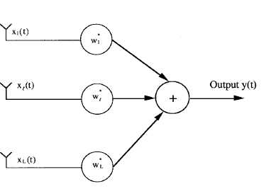
Narrow-band beam-former structure
SEVERAL
BEAM -FORMING
METHODS…

Slide 16
SEVERAL BEAM-FORMING METHODS …

Slide 17
SEVERAL BEAM-FORMING METHODS …
zero mean stationary process
The mean output power of the processor is :
Where R is the array correlation matrix :
: correlation between i th and j th element .

Slide 18
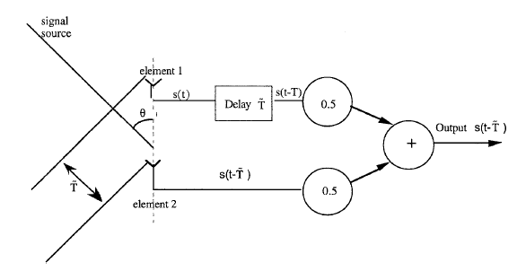
Conventional (delay and sum) beam-former
Two-element delay and sum beam-former structure

Slide 19
SEVERAL BEAM-FORMING METHODS …
Null-steering Beam-Former :
Goal :
Producing a null in the response pattern in a
response pattern in a known direction
Cancelling the plane wave arriving from that
direction

Slide 20
SEVERAL BEAM-FORMING METHODS …
Limitations of null-steering beam-former :
It requires knowledge of the directions of interferers.
It does not maximize the output SNR .
The optimal beam-forming
overcome these limitations .

Slide 21
SEVERAL BEAM-FORMING METHODS …
Optimal Beam-Forming (in the sense of output SINR ) :
Optimal beam-former solves the following
optimization problem :
Where is the mean output power.

Slide 22
SEVERAL BEAM-FORMING METHODS …
Minimizing the total output power while
maintaining the desired signal power in the output
equal to the desired source power
Maximizing the output SINR
An increase of a few decibels in the output SNR
can make a significant increase in the
channel capacity of the system possible.

Slide 23
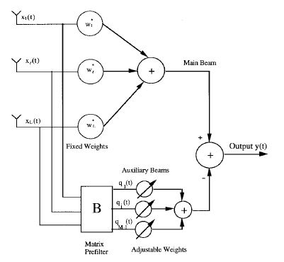
Beam-Space Processing

Slide 24
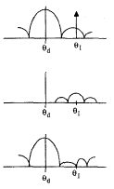
Main beam
Weighted sum of secondary beams
Final output

Slide 25
SEVERAL BEAM-FORMING METHODS …
Other beam-formers
Broad- band beam-formers
Frequency-domain beam-former
…

Slide 26
CONTENT
Introduction
Smart antenna and SDR
Several beam-forming methods
Essential signal-processing algorithms
Adaptive beam-forming algorithms
summery

Slide 27
ADAPTIVE BEAM-FORMING ALGORITHMS
Adaptive Algorithms :
To calculate the optimal weights (in different senses)
we usually need the correlation matrix R.
For example in optimal beam-former the solution of
the optimization problem is :
However, in practice R is not available .

Slide 28
ADAPTIVE BEAM-FORMING ALGORITHMS …
The weights are adjusted using available
information derived from the array output, array
signals and so on to make an estimate of the
optimal weights.
There are many such schemes, which are normally
referred to adaptive algorithms .

Slide 29
ADAPTIVE BEAM-FORMING ALGORITHMS …
LMS Algorithm (unconstrained) :
Reference signal :
For some applications, enough may be known about
the desired signal (arriving from the look direction )
to generate an appropriate reference signal.
The weights are chosen to minimize the
mean square error between the beam-former
output and the reference signal.

Slide 30
ADAPTIVE BEAM-FORMING ALGORITHMS …
For example, if the desired signal is
amplitude modulated, then acceptable performance
is often obtained by setting the reference signal equal
to the carrier.
In the unconstrained LMS algorithm reference signal
is used.

Slide 31
ADAPTIVE BEAM-FORMING ALGORITHMS …
In this algorithm :
Where :
: new weights computed at the (n+1) th iteration
: a positive scalar ( gradient step size )
: an estimate of the gradient of the MSE
between the beam-former output and the reference signal

Slide 32
ADAPTIVE BEAM-FORMING ALGORITHMS …
Mean=
Estimated weights
Covariance =

Slide 33
ADAPTIVE BEAM-FORMING ALGORITHMS …
The algorithm updates the weights at each iteration by
estimating the gradient of the MSE surface and then
moving the weights in the negative direction of the
gradient by a small amount .
should be small enough for convergence of the
algorithm to the optimum weights .
(convergence : convergence the mean of the
estimated weights to the optimal weights )

Slide 34
ADAPTIVE BEAM-FORMING ALGORITHMS …
Convergence speed :
The speed by which the mean of the estimated
weights (ensemble average of many trials) approaches
the optimal weights .
The larger the eigenvalue spread of the correlation
matrix R, the longer it takes for the algorithm to
converge.

Slide 35
ADAPTIVE BEAM-FORMING ALGORITHMS …
The availability of time for an algorithm to converge
for mobile communications depends on:
1-System design the duration that the user signal is
present (e.g. User slot duration in a TDMA system)
2-The rate of the fading :
The higher the rate at which the signal fades algorithm needs to converge faster

Slide 36
ADAPTIVE BEAM-FORMING ALGORITHMS …
Even when the mean of the estimated weights
converges to the optimal weights, they have finite
covariance .
The average MSE is more than MMSE
Misadjustment = ( average excess MSE ) /MMSE
Misadjustment the size of the region that weights wandering around it after the convergence.

Slide 37
ADAPTIVE BEAM-FORMING ALGORITHMS …
Increasing increases the misadjustment .
An increase in causes the algorithm to converge
faster.
We have a trade off in
the selection of the gradient step size

Slide 38
ADAPTIVE BEAM-FORMING ALGORITHMS …
This trade off is between :
1-Reaching vicinity of the solution point more quickly
but wandering around over a larger region and causing
a bigger misadjustment .
2-Arriving near the solution point slowly with the
smaller movement in the weights at the end.

Slide 39
ADAPTIVE BEAM-FORMING ALGORITHMS …
We select based on the following considerations :
The mentioned trade off
Being small enough for convergence
Application and requirements

Slide 40
CONTENT
Introduction
Smart antenna and SDR
Several beam-forming methods
Essential signal-processing algorithms
Adaptive beam-forming algorithms
summery

Slide 41
SUMMARY
Smart antenna
Beam-forming
Diversity combining
…
Smart antenna and SDR
Different beam-formers
Delay and sum beam-former

Slide 42
SUMMARY
Null-steering beam-former
Optimal beam-former
Correlation matrix R is required
R is not available in practice
Adaptive algorithms
LMS algorithm
Trade off in selecting step size

Slide 43
QUESTIONS ?

Slide 44
THANKS FOR YOUR ATTENTION

