Slide 1
Spectrum Sensing Algorithms for Cognitive Radio Applications
Presented By :
Reza Khodabandeh Samani

Slide 2
Introduction
Challenges
Spectrum Sensing Methods For Cognitive Radio
Spectrum Sensing In Current Wireless Standards
Spectrum Sensing In IEEE 802.22

Slide 3
Definition :
definition adopted by Federal Communications Commission (FCC): “Cognitive radio: A radio or system that senses its operational electromagnetic environment and can dynamically and autonomously adjust its radio operating parameters to modify system operation, such as maximize throughput, mitigate interference, facilitate interoperability, access secondary markets.”

Slide 4
Multi-Dimensional Spectrum Awareness
Spectrum Opportunity : a band of frequencies that are not being used by the primary user of that band at a particular time in a particular geographic area
Other Dimensions :
Code Dimension
Angle Dimension

Slide 5
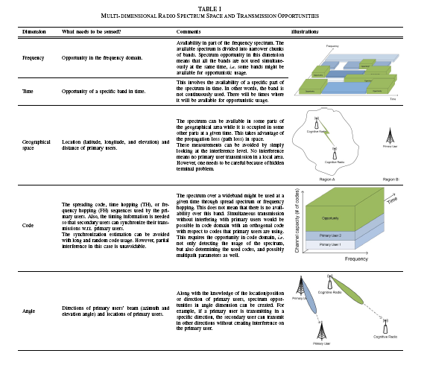

Slide 6
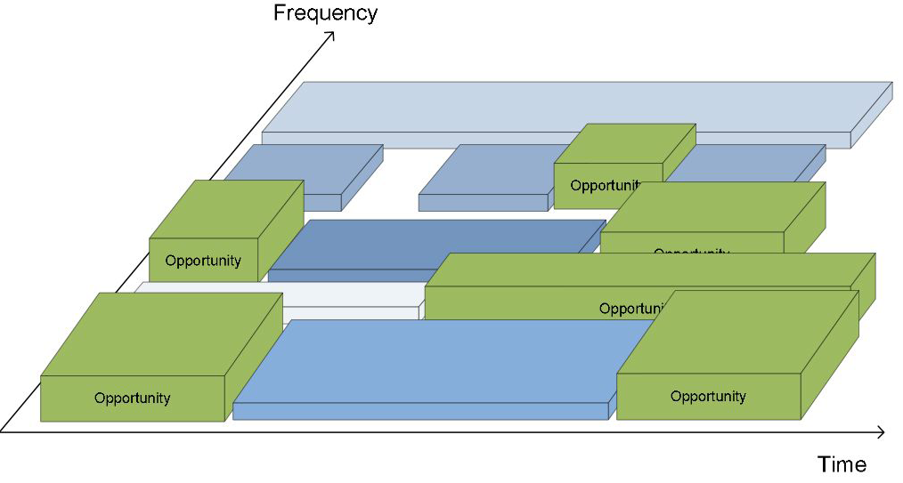
Frequency and Time Dimension

Slide 7
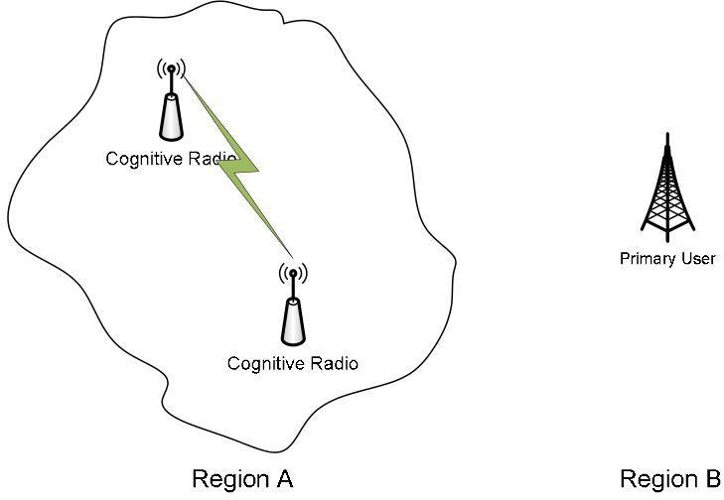
Geographical Space Angle

Slide 8
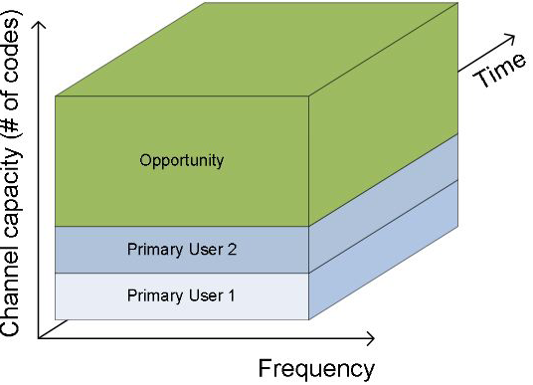
Code Dimension

Slide 9
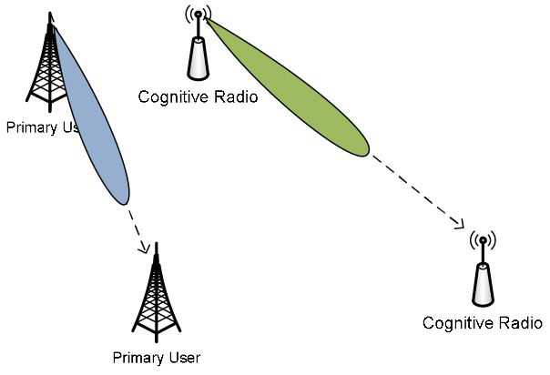
Angle Dimension

Slide 10
Challenges
Hardware Requirements
Hidden Primary User Problem
Detecting Spread Spectrum Primary Users
Sensing Duration and Frequency
Decision Fusion in Cooperative Sensing
Security

Slide 11
Spectrum Sensing Methods For Cognitive Radio
Energy Detector Based Sensing
Waveform-Based Sensing
Cyclostationarity-Based Sensing
Radio Identification Based Sensing
Matched-Filtering

Slide 12
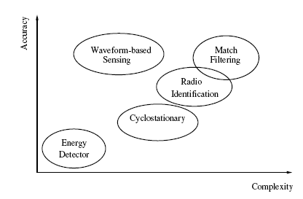
Comparison of Various Sensing Methods

Slide 13
Waveform-based sensing is more robust than energy detector and cyclostationarity based methods because of the coherent processing that comes from using deterministic signal component.
cyclostationary-based methods perform worse than energy detector based sensing methods when the noise is stationary.

Slide 14
While selecting a sensing method, some tradeoffs should be considered. The characteristics of primary users are the main factor in selecting a method. Cyclostationary features contained in the waveform, existence of regularly transmitted pilots, and timing/frequency characteristics are all important.
Other factors include required accuracy, sensing duration requirements, computational complexity, and network requirements.

Slide 15
Other Sensing Methods
Centralized Sensing
Distributed Sensing
External Sensing

Slide 16
Spectrum Sensing In Current Wireless Standards
IEEE 802.11k
A proposed extension to IEEE 802.11 specification is IEEE 802.11k which defines several types of measurements. It also creates and updates a radio neighborhood map and report. Some of the measurements include channel load report, noise histogram report and station statistic report.
The noise histogram report provides methods to measure interference levels that display all non-802.11 energy on channel as received by the subscriber unit.

Slide 17
AP collects channel information from each mobile unit and makes its own measurements. This data is then used by the AP to regulate access to a given channel.
The sensing (or measurement) information is used to improve the traffic distribution within a network as well.
WLAN devices usually connect to the AP that has the strongest signal level. Sometimes, such an arrangement might not be optimum and can cause overloading on one AP and underutilization of others.
In 802.11k, when an AP with the strongest signal power is loaded to its full capacity, new subscriber units are assigned to one of the underutilized APs. Despite the fact that the received signal level is weaker, the overall system throughput is better thanks to more efficient utilization of network resources.

Slide 18
Bluetooth
A new feature, namely adaptive frequency hopping (AFH),is introduced to the Bluetooth standard to reduce interference between wireless technologies sharing the 2.4GHz unlicensed radio spectrum.
In this band, IEEE 802.11b/g devices, cordless telephones, and microwave ovens use the same wireless frequencies as Bluetooth.
AFH identifies the transmissions in the industrial, scientific and medical (ISM) band and avoids their frequencies.

Slide 19
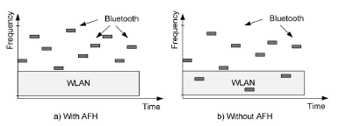
Bluetooth transmission with and without adaptive frequency hopping(AFH). AFH prevents collusions between WLAN and Bluetooth transmissions.
AFH requires a sensing algorithm for determining whether there are other devices present in the ISM band and whether or not to avoid them.

Slide 20
The sensing algorithm is based on statistics gathered to determine which channels are occupied and which channels are empty
Channel statistics can be packet-error rate, BER, received signal strength indicator (RSSI), carrier to-interference-plus-noise ratio (CINR) or other metrics.

Slide 21
IEEE 802.22
IEEE 802.22 standard is known as cognitive radio standard because of the cognitive features it contains.
One of the most distinctive features of the IEEE 802.22 standard is its spectrum sensing requirement.
IEEE 802.22 based wireless regional area network (WRAN) devices sense TV channels and identify transmission opportunities. The functional requirements of the standard require at least 90% probability of detection and at most 10% probability of false alarm for TV signals with -116 dBm power level or above.

Slide 22
The sensing is envisioned to be based on two stages: fast and fine sensing .In the fast sensing stage, a coarse sensing algorithm is employed, e.g. energy detector. The fine sensing stage is initiated based on the fast sensing results.
Fine sensing involves a more detailed sensing where more powerful methods are used. Several techniques that have been proposed and included in the draft standard include energy detection, waveform-based sensing (PN511 or PN63 sequence detection and/or segment sync detection), cyclostationary feature detection, and matched filtering.

Slide 23
A base station (BS) can distribute the sensing load among subscriber stations (SSs).The results are returned to the BS which uses these results for managing the transmissions.
Another approach for managing the spectrum in IEEE 802.22 devices is based on a centralized method for available spectrum discovery. The BSs would be equipped with a global positioning system (GPS) receiver which would allow its position to be reported. The location information would then be used to obtain the information about available TV channels through a central server.

Slide 24
For low-power devices operating in the TV bands, e.g. wireless microphone and wireless camera, external sensing is proposed as an alternative technique. These devices periodically transmit beacons with a higher power level. These beacons are monitored by IEEE 802.22 devices to detect the presence of such low-power devices which are otherwise difficult to detect due to the low-power transmission.

Slide 25
conclusions
Spectrum is a very valuable resource in wireless communication systems, and it has been a focal point for research and development efforts over the last several decades.
Cognitive radio, which is one of the efforts to utilize the available spectrum more efficiently through opportunistic spectrum usage, has become an exciting and promising concept.
One of the important elements of cognitive radio is sensing the available spectrum opportunities. the spectrum opportunity and spectrum sensing concepts are re-evaluated by considering different dimensions of the spectrum space.
The new interpretation of spectrum space creates new opportunities and challenges for spectrum sensing while solving some of the traditional problems.

Slide 26
References
[1] P. Kolodzy et al., “Next generation communications: Kickoff meeting,” in Proc. DARPA, Oct. 2001
[2] W. D. Horne, “Adaptive spectrum access: Using the full spectrum space,” in Proc. Annual Telecommunications Policy Research Conf., Arlington, Virginia, Oct. 2003.
[3] S. Geirhofer, L. Tong, and B. Sadler, “Dynamic spectrum access in the time domain: Modeling and exploiting white space,” IEEE Commun. Mag., vol. 45, no. 5, pp. 66–72, May 2007.
[4] Y. Hur, J. Park, W. Woo, K. Lim, C. Lee, H. Kim, and J. Laskar, “A wideband analog multi-resolution spectrum sensing (MRSS) technique for cognitive radio (CR) systems,” in Proc. IEEE Int. Symp. Circuits and Systems, Island of Kos, Greece, May 2006, pp. 4090–4093.
[5] M. McHenry, E. Livsics, T. Nguyen, and N. Majumdar, “XG dynamic spectrum sharing field test results,” in Proc. IEEE Int. Symposium on New Frontiers in Dynamic Spectrum Access Networks, Dublin, Ireland, Apr. 2007, pp. 676–684.
[6] D. Cabric, A. Tkachenko, and R. Brodersen, “Spectrum sensing measurements of pilot, energy, and collaborative detection,” in Proc. IEEE Military Commun. Conf., Washington, D.C., USA, Oct. 2006, pp. 1–7.
[7] C. Cordeiro, K. Challapali, and D. Birru, “IEEE 802.22: An introduction to the first wireless standard based on cognitive radios,” Journal of communications, vol. 1, no. 1, Apr. 2006.
[8] A. Ghasemi and E. Sousa, “Optimization of spectrum sensing for opportunistic spectrum access in cognitive radio networks,” in Proc. IEEE Consumer Commun. and Networking Conf., Las Vegas, Nevada, USA, Jan. 2007, pp. 1022–1026.
[9] F. Digham, M. Alouini, and M. Simon, “On the energy detection of unknown signals over fading channels,” in Proc. IEEE Int. Conf. Commun., vol. 5, Seattle, Washington, USA, May 2003, pp. 3575– 3579.

Slide 27
Thank You
Any Question?

