Slide 1
دانشگاه صنعتی اصفهان
دانشکده برق و کامپیوتر
Embedded processor
علی مجیدی
8604664
1
1

Slide 3
Atmel
Atmel Corporation, founded in 1984
Headquarters San Jose, California, USA
focus on flash microcontrollers
secured products, RF and automotive integrated circuits
Revenue ▼$1.57 billion USD (2008)
Net income ▼$27.2 million USD (2008)
Employees 6,000

Slide 4
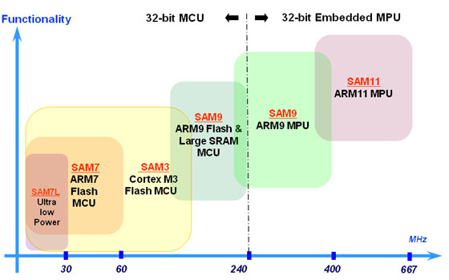
Atmel(ARM)
ARM-based Microcontrollers

Slide 5
Atmel(ARM)
AT91SAM9 Series
the same programming model as ARM7-based
It supports deterministic, real-time operation
ARM926EJ-S processor
210 MIPS with a 190 MHz clock
8K bytes of SRAM and 32K bytes of ROM
USB Full /high Speed Host and Device interfaces, a 10/100 Base T Ethernet MAC
USARTs, Synchronous Serial Controllers (SSC), Master/Slave Serial Peripheral Interfaces (SPI), a three-channel 16-bit Timer Counter (TC), a Two Wire Interface (TWI) and four-channel 10-bit ADC

Slide 6
Atmel(ARM)
AT91SAM9XE Series
the same programming model as ARM7-based
It supports deterministic, real-time operation
ARM926EJ-S processor
210 MIPS with a 190 MHz clock
8K bytes of SRAM and 32K bytes of ROM
USB Full Speed Host and Device interfaces, a 10/100 Base T Ethernet MAC
USARTs, Synchronous Serial Controllers (SSC), Master/Slave Serial Peripheral Interfaces (SPI), a three-channel 16-bit Timer Counter (TC), a Two Wire Interface (TWI) and four-channel 10-bit ADC
Peripheral DMA Controller (PDC):(This industry-leading distributed DMA architecture ensures that internal data transfers occur at maximum possible bandwidth with minimal processor intervention)

Slide 7
Atmel(DIOPSIS)
DIOPSIS® (ARM + DSP)
is a dual-core processing platform
integrating a floating-point Magic DSP™ and an ARM926EJ-S RISC microprocessor
40-bit floating-point provides high dynamic range
2.3 Mbit of internal memories
full speed USB host/device, Ethernet MAC, 4xSSC, 3xUSART, 2xSPI, Time Counter, 2xTWI, 2xCAN, Multimedia Card Interface
1 billion floating point operations per second from the DSP, plus 220 MIPS from ARM

Slide 8
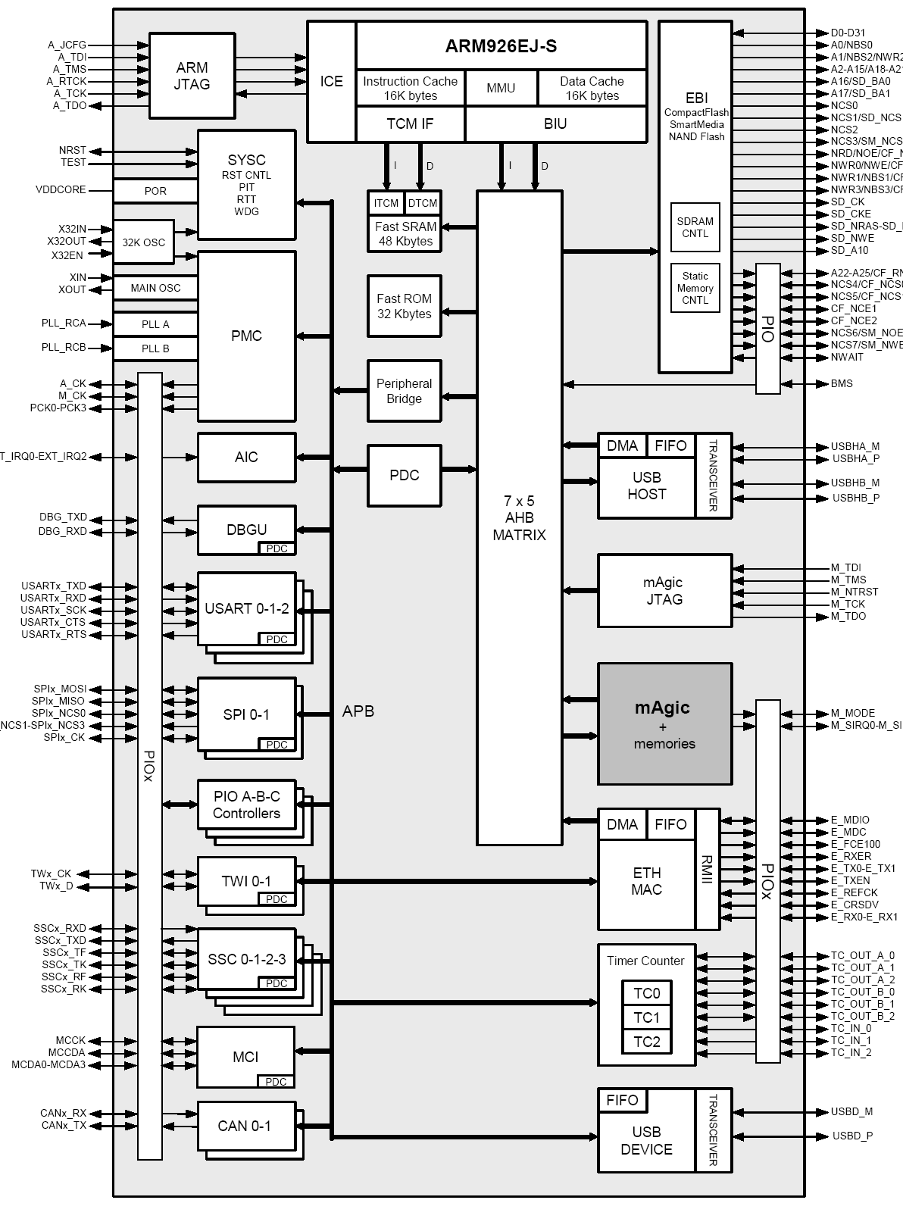
Atmel(DIOPSIS)

Slide 9
Founded Cambridge, Massachusetts (1965)
Products Semiconductors
company specializing in data conversion and signal conditioning technology
Revenue $2.6 billion USD (2008)
Employees 8,500 (2009)

Slide 10
Analog device (ADSP-21xx)
ADSP-21xx
Compatible DSP with performance up to 160MHz
Ideal for speech processing and voice-band modems ,as well as real-time control application
cheap ($10~$15)
75 MIPS Sustained Performance
Single-Cycle Instruction Execution

Slide 11
Analog device (ADSP-21xx)
FEATURES
3-Bus Architecture Allows Dual Operand Fetches in Every Instruction Cycle
80K Bytes of On-Chip RAM
16K Words Program Memory RAM
16K Words Data Memory RAM
Two Independent Data Address Generators
Flexible I/O Structure Allows 2.5 V or 3.3 V Operation
16-Bit Internal DMA
Automatic Booting of On-Chip Program Memory
4 MByte Memory Interface for Storage of Data Tables

Slide 12
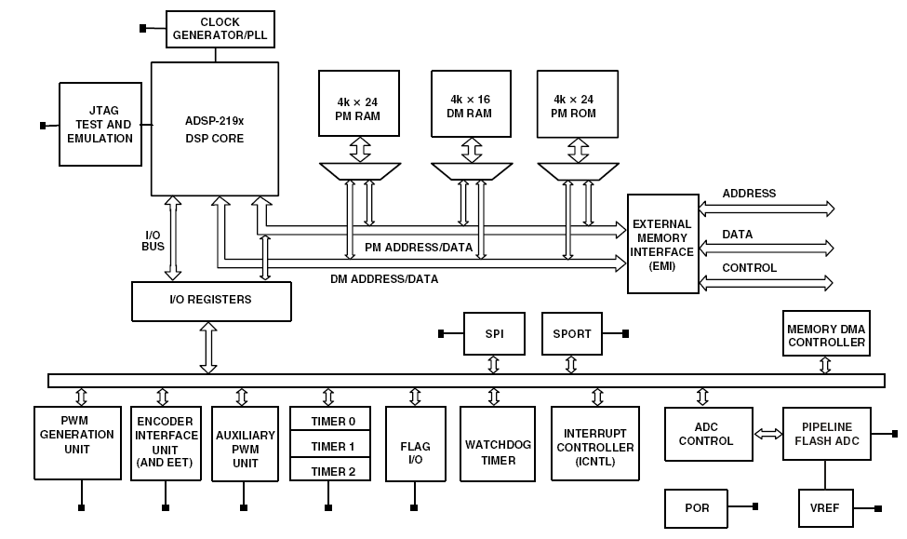

Slide 13
Analog device (ADSP-21xx)
The processor contains three independent computational units:
the ALU(16 bit , standard set of arithmetic and logic operations and division)
the multiplier/accumulator (MAC)
the shifter
BUS
Program Memory Address (PMA) Bus
Program Memory Data (PMD) Bus
Data Memory Address (DMA) Bus
Data Memory Data (DMD) Bus
Result (R) Bus

Slide 14
ADSP-21xx Family
 | Performance |  | Packaging & Temp Range |  | Memory |  |  | Peripherals |  |  |  |  | Development Tools
 | Clock Speed MHz (Max) | External (IO) Supply Voltage | Package | Temp Range | Program RAM Words | Data RAM Word (KWords) | Ext. Memory Bus (Bits) | Timers | Host Port | SPORT | SPI/UART | ADC | Evaluation Board | Development Software
 |  |  |  |  | (KWords)
ADSP-21990 | 160 | 3.3 | 176 LQFP, 196 CSP_BGA | Industrial | 4 | 4 | 24 | 3 | Yes | 1 | Yes | 14 bit Dual Ch, 20 MSPS | 21992 EZ-KIT Lite | VisualDSP++
ADSP-21991 | 160 | 3.3 | 176 LQFP, 196 CSP_BGA | Industrial | 32 | 8 | 24 | 3 | Yes | 1 | Yes | 14 bit Dual Ch, 20 MSPS | 21992 EZ-KIT Lite | VisualDSP++
ADSP-21992 | 160 | 3.3 | 176 LQFP, 196 CSP_BGA | Industrial | 32 | 16 | 24 | 3 | Yes | 1 | Yes | 14 bit Dual Ch, 20 MSPS | 21992 EZ-KIT Lite | VisualDSP++
ADSP-2191M | 160 | 3.3 | 144 LQFP, 144 CSP_BGA | Industrial, Commercial | 32 | 32 | 16 | 3 | Yes | 3 | Yes | 0 | 21992 EZ-KIT Lite | VisualDSP++
ADSP-2196M | 160 | 3.3 | 144 LQFP, 144 CSP_BGA | Industrial, Commercial | 8 | 8 | 16 | 3 | Yes | 3 | Yes | 0 | 21992 EZ-KIT Lite | VisualDSP++
ADSP-2188N | 80 | 1.8, 2.5, 3.3 | 144 LQFP, 144 CSP_BGA | Industrial, Commercial | 48 | 56 | 24 | 1 | Yes | 2 | No | 0 | 2189M EZ-KIT Lite | VisualDSP++
ADSP-2189N | 80 | 1.8, 2.5, 3.3 | 144 LQFP, 144 CSP_BGA | Industrial, Commercial | 32 | 48 | 24 | 1 | Yes | 2 | No | 0 | 2189M EZ-KIT Lite | VisualDSP++
ADSP-2187N | 80 | 1.8, 2.5, 3.3 | 144 LQFP, 144 CSP_BGA | Industrial, Commercial | 32 | 32 | 24 | 1 | Yes | 2 | No | 0 | 2189M EZ-KIT Lite | VisualDSP++
ADSP-2185N | 80 | 1.8, 2.5, 3.3 | 144 LQFP, 144 CSP_BGA | Industrial, Commercial | 16 | 16 | 24 | 1 | Yes | 2 | No | 0 | 2189M EZ-KIT Lite | VisualDSP++
ADSP-2186N | 80 | 1.8, 2.5, 3.3 | 144 LQFP, 144 CSP_BGA | Industrial, Commercial | 8 | 8 | 24 | 1 | Yes | 2 | No | 0 | 2189M EZ-KIT Lite | VisualDSP++
ADSP-2184N | 80 | 1.8, 2.5, 3.3 | 144 LQFP, 144 CSP_BGA | Industrial, Commercial | 4 | 4 | 24 | 1 | Yes | 2 | No | 0 | 2189M EZ-KIT Lite | VisualDSP++
ADSP-2188M | 75 | 2.75, 3.3 | 144 LQFP, 144 CSP_BGA | Industrial, Commercial | 48 | 56 | 24 | 1 | Yes | 2 | No | 0 | 2189M EZ-KIT Lite | VisualDSP++
ADSP-2189M | 75 | 2.5, 3.3 | 144 LQFP, 144 CSP_BGA | Industrial, Commercial | 32 | 48 | 24 | 1 | Yes | 2 | No | 0 | 2189M EZ-KIT Lite | VisualDSP++
ADSP-2185M | 75 | 2.5, 3.3 | 144 LQFP, 144 CSP_BGA | Industrial, Commercial | 16 | 16 | 24 | 1 | Yes | 2 | No | 0 | 2189M EZ-KIT Lite | VisualDSP++
ADSP-2186M | 75 | 2.5, 3.3 | 144 LQFP, 144 CSP_BGA | Industrial, Commercial | 8 | 8 | 24 | 1 | Yes | 2 | No | 0 | 2189M EZ-KIT Lite | VisualDSP++

Slide 15
Analog device (Blackfin Embedded Processor)
Application
Multi-format audio
Video
Voice and image processing
Multi-mode baseband and packet processing
Control processing
Real-time security
16-/32 bit embedded processor

Slide 16
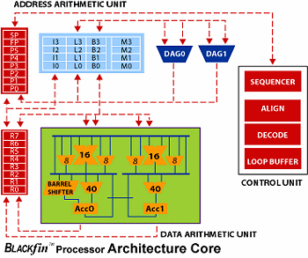

Slide 17
Analog device (Blackfin Embedded Processor)
Data arithmetic unit
Two 12-bit MACs(the multiplier/accumulator )
Two 40-bit ALUs
Four 8-bit video intrface
Single barrel shifter
Address arithmetic unit
Memory fetch
Index,length,base,and modify registers
Circular buffering

Slide 18
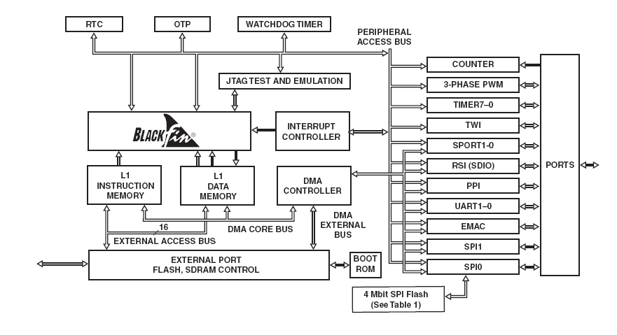
ADSP-BF512

Slide 19
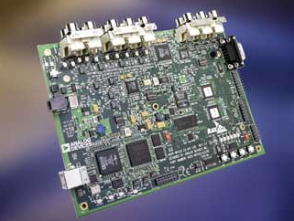
ADSP-BF512
FEATURES
Up to 400MHz high-performance Blackfin® processor
Two 16-bit MACs, two 40-bit ALUs, four 8-bit video ALUs,
40-bit shifter
168-ball CSP_BGA
176-lead LQFP with exposed pad
IEEE 802.3-compliant 10/100 Ethernet MAC
Parallel peripheral interface (PPI),
2 dual-channel, full-duplex synchronous serial ports
(SPORTs), supporting 8 stereo I2S channels
12 peripheral DMAs, 2 UARTs, 32-bit core timer
On-chip PLL capable of 0.5to 64 frequency multiplicatio
EZ-kit
ASDP-BF533
AD1836 96Khz audio codec
ADV7171 video encoding
2MB flash memory

Slide 20
Analog device (SHARC)
SHARC
Floating point DSP
At 200 MHz (5 ns) core instruction rate, 1200 MFLOPS (Million Floating Point Operation Per Second) peak/800 MFLOPS sustained
2M bits on-chip dual-ported SRAM
Up to 4M bits on-chip dual-ported mask-programmable ROM
Transfers between memory and core at up to four 32-bit floating- or fixed-point words per cycle, sustained 2.4 Bps bandwidth at 200 MHz core instruction rate; 900 Mbps is available via DMA
Serial peripheral interface (SPI) , PLL has a wide variety
Price($180~$270)

Slide 21
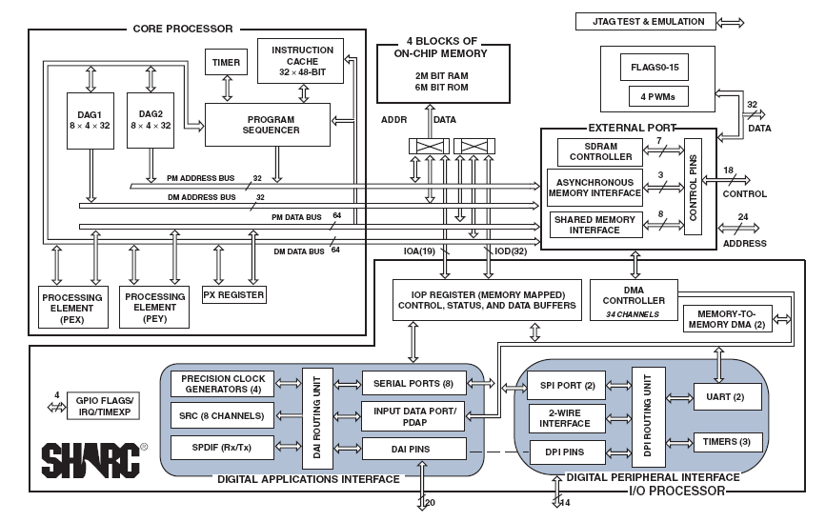

Slide 22
Founded in Silicon Valley in 1984 and headquartered in San Jose, California
Headquarters: San Jose, California
Industry :Integrated Circuits
Products:FPGAs, CPLDs
Revenue: $1.91 billion (2008)
Employees:3,100

Slide 23
Xilinx(Embedded Processing )
Solutions
High performance PowerPC® 440 and PowerPC 405 32-bit hard processors
Flexible 32-bit MicroBlaze™ soft processor
Award winning Platform Studio and the Embedded Development Kit (EDK)

Slide 24
Xilinx(PowerPC)
PowerPC Hard Processor
The IBM PowerPC 440 and 405 cores are hard 32-bit RISC CPU processors immersed directly into the Xilinx Virtex FPGA fabric to implement high performance embedded applications
The PowerPC 440 is incorporated in the Virtex-5 FXT
128-bit interfaces and point-to-point connectivity
Integrated DMA channels
Processor Local Bus (PLB) interfaces minimize logic
The PowerPC 405 is supported in both the Virtex-4 and Virtex-II Pro
memory management unit (MMU)
-stage pipeline

Slide 25
PowerPC 405(Virtex-4 FX FPGAs)
Virtex-4 FX FPGA Benefits
Implement high speed serial connectivity with RocketIO™ serial transceivers
Up to 24 transceivers, each providing 622 Mbps to 6.5 Gbps, full duplex operation
Enable flexible bridging between emerging serial standards and existing parallel standards
Provides unique tri-mode Ethernet Media Access Controller (MAC) blocks for guaranteed performance
10/100 Mbps mode, 1000 Mbps mode, 10/100/1000 Mbps mode
Accelerate processing performance with IBM PowerPC™ 32-bit RISC processor with APU controller
700+ DMIPS @ 450 MHz; up to 1,400+ DMIPS in a single FPGA with two processors
Low power consumption: 0.45 mW/MHz
Auxiliary Processor Unit (APU) controller makes it easy to integrate hardware accelerators

Slide 26
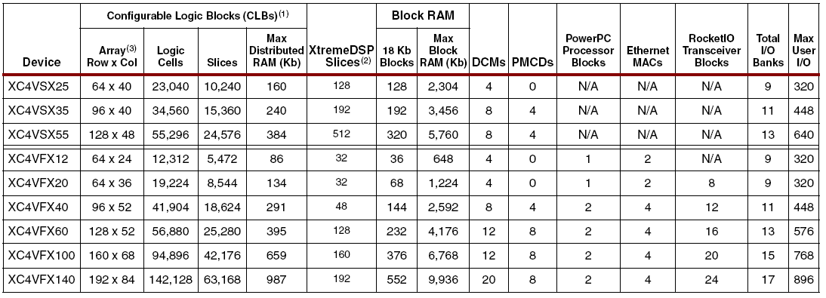
Virtex-4FPGAs
Summary of Virtex-4 Family Features
Digital clock manager (DCM) blocks
Additional phase-matched clock dividers (PMCD)
Differential global clocks
Optional pipeline stages
Built-in Accumulator (48-bit) and Adder/Subtracter
Distributed RAM &SDRAM
Optional programmable FIFO logic automatically

Slide 27
Virtex-4 FX
System Blocks Specific to the Virtex-4 FX Family
RocketIO Multi-Gigabit Transceiver (MGT)
Full-duplex serial transceiver (MGT) capable of 622 Mb/s to 6.5 Gb/s baud rates
CRC generation and checking
Programmable TX pre-emphasis or pre-equalization
On-chip RX AC coupling
PowerPC 405 RISC Core
Embedded PowerPC 405 (PPC405) core
Up to 450 MHz operation
Five-stage data path pipeline
16 KB instruction cache
16 KB data cache
Enhanced instruction and data on-chip memory(OCM) controllers
Additional frequency ratio options between PPC405 and Processor Local Bus
Auxiliary Processor Unit (APU) Interface for directconnection from PPC405 to coprocessors in fabric
APU can run at different clock rates
4-cycle cache line transfer
Tri-Mode Ethernet Media Access Controller
IEEE 802.3 compliant
Operates at 10, 100, and 1,000 Mb/s
Supports tri-mode auto-detect
Flexible, user-configurable host interface

Slide 28
Virtex-5
Optimized for embedded processing, DSP, and memory-intensive applications with highest-speed serial I/O
Up to two PowerPC® 440 processors with 32-bit RISC cores, each in its own embedded peripheral block
Enable higher levels of DSP integration and lower power consumption with up to 320 DSP48E slices
25 x 18, two’s complement, multiplication
Optional pipelining

Slide 29
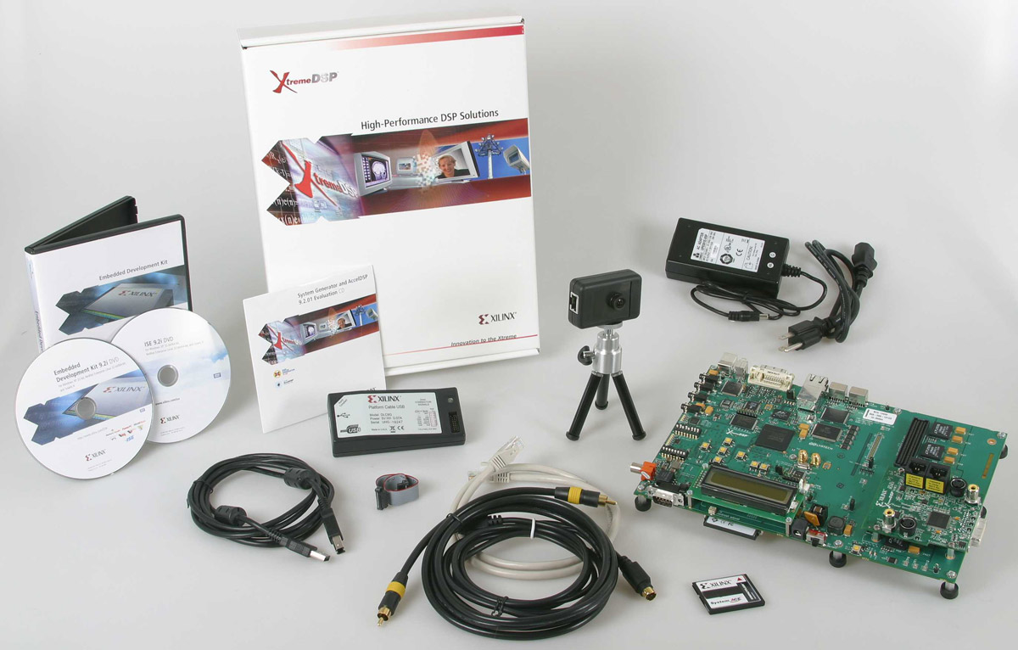
Xilinx(DSP)
Virtex-DSP and Spartan-DSP Series
Virtex-6 SXT Devices
Spartan-6 LXT Devices
Virtex-5 SXT Devices
Spartan-3A DSP Devices
XtremeDSP Video Starter Kit — Spartan-3A DSP Edition
evaluate Xilinx FPGA(s) in a wide range
of Video and Imaging applications
$1,595
EDK(application)& system genarator

Slide 30
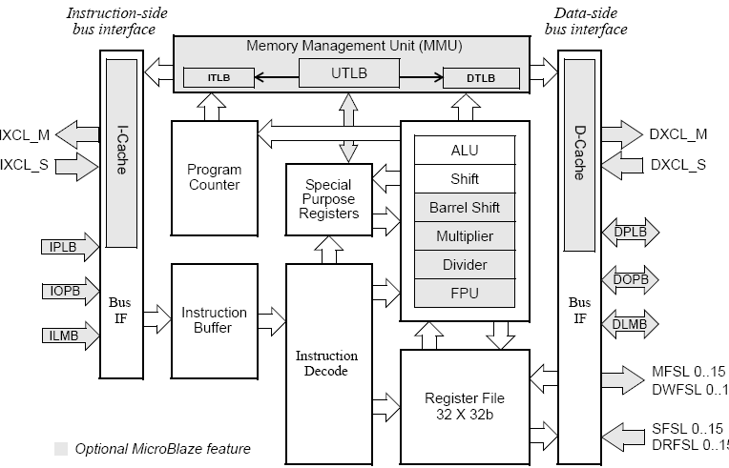
MicroBlaze Processor
KCPSM3
Thirty-two 32-bit general purpose registers
32-bit address bus

Slide 31
Nios II Processor
Create an exact mix of peripherals, memory interfaces, and hardware accelerators for your application
Cortex-M1
The ARM Cortex-M1 processor addresses the need for a high-quality, standard processor architecture for Altera® FPGA applications allowing you to choose the optimal implementation for each project
V1 ColdFire (freescale)
The small-footprint V1 ColdFire core is designed for entry-level 32-bit applications. It enhances system utilization, resulting in low-power consumption, while giving more than ten times the performance of an 8-bit MCU

Slide 32
Altera( Nios II Processor)
Choose the exact set of CPUs, peripherals, and interfaces needed for your application
Lower overall cost, complexity, and power consumption—combining many functions onto one chip
Increase performance without changing your board design—accelerating only functions that need it
Nios II processors offer you tremendous flexibility
Using SOPC Builder and included embedded peripherals, you create the exact set of peripherals, memories, and I/O circuitry needed for any application, even configurations not available in off-the-shelf processors

Slide 33
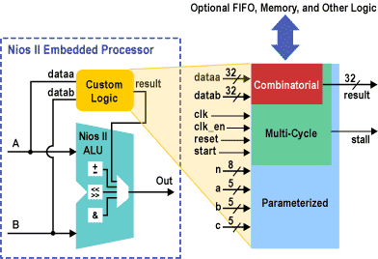
Altera( Nios II Processor)
Standard Peripherals
The Nios II processor includes a library of commonly used peripherals and interfaces that are available
JTAG UART
Common Flash Interface
UART
Interval Timer
Parallel I/O (PIO)
Serial Peripheral Interface (SPI)
DMA Controller
SDRAM Controller :
On-chip ROM and RAM
SDRAM, SSRAM, SRAM,
and flash
Memory Interfaces
Ethernet Port

Slide 34
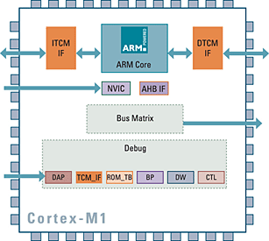
Altera(Cortex-M1)
Features
Streamlined three-stage 32-bit ARM® Cortex processor
Optimized for implementation in FPGAs, targets Altera Cyclone® III FPGAs
Supported by a wide variety of tools and operating systems in the ARM Connected Community
Tightly coupled memories for rapid access to on-chip block RAM
Optional debug, breakpoint, and watchpoint unit
Configurable Tightly Coupled Memories

Slide 35
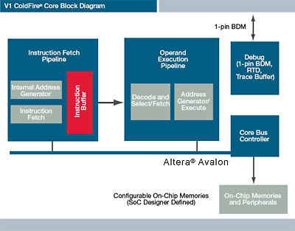
Altera(V1 ColdFire)
Features
1-pin background debug mode (BDM), real-time debug (RTD) support, works with existing ColdFire debugging tools
Optimized for the Altera® Cyclone® III FPGAs
$0 licensing fee and $0 royalty for the core
Fully synthesizable core
16 user-accessible, 32-bit wide general-purpose registers
Independent, decoupled pipelines
FIFO instruction buffer provides decoupling
2-stage instruction fetch pipeline (IFP)

Slide 36
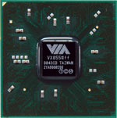
VIA VX800
The VIA VX800 media system processor is an all-in-one
800/400MHz FSB
Supports up to two 64-bit DDR2 667 DIMMs (4 GB max)
Up to 32-bit sample depth at 192 kHz sampling rate
Supports three codecs and eight streams
250MHz engine clock
128-bit 2D engine with hardware rotation capability
Up to 256 MB frame buffer
18-bit TTL LCD interface
Multiplexed with UART and IR ports
Supports SATA 2.0 interface
Supports PCI-Express one 4-lane and two 1-lane ports
Supports six USB 2.0 ports
VIA VX855 zdf
VIA Eden™ and Eden™ ULV Processors

Slide 37
Thank you
Question?

