Slide 1
Security in SDR & cognitive radio
Ali Shamsizadeh
Summer 2009

Slide 2
Introduction
Background on Network Security
Security Concerns in Mobile Systems
Security in SDR
Secure Software Download in SDR
Security in Cognitive Radio
Security Threats in Cognitive Radio Networks

Slide 3
Background on Network Security
Authentication:
“Who are you?”
Authorization:
“Should you be doing that?”
Confidentiality:
“If someone gets the packets, can they recover the information?”
Integrity:
“Is what I get really what I should get?”

Slide 4
Background on Network Security
Hostile environment
A third party might want to disturb communication
Attacks might be against
confidentiality
integrity
originality
Or the service (denial of service)

Slide 5
Background on Network Security
Application security requirements
• Eavesdropping protection
(encryption)
• Impersonation and integrity protection
(authenticated and hashed messages)
• Denial of service protection
• Secure device configuration and user identification
• Security for an unreliable channel

Slide 6
Security Concerns in Mobile Systems
User identification
Secure storage
A secure software execution environment
tamper-resistant system
Secure network access
Secure data communications
Content security

Slide 7
Security Concerns in Mobile Systems
Attack scenarios (third radio)
Transmit noise at a frequency that might be in use
Spread noise at available frequencies by jumping
Listen for transmission and transmit noise at that frequency (may include jumping)
Replay, modify, inject messages

Slide 8
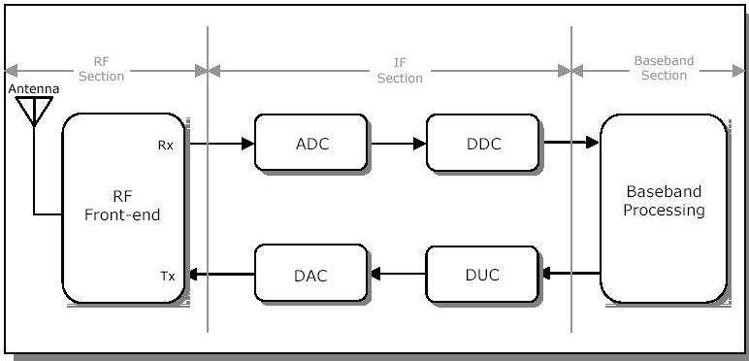
Security in SDR
the functions of software-defined radio (SDR) can be changed by changing its software. Therefore, many security problems that have never been seen in the conventional fixed wireless terminals will arise.

Slide 9
Security in SDR
Requirements
Policy-driven behavior
An SDR device SHALL enforce a device-specific SDR security policy that governs the behavior of the device at all times.
Policy freshness
The SDR device SHALL ensure that its device-specific SDR security policy incorporates the SDR security policies of its stakeholders within the scope of their authority.
Device attestation
An SDR device SHALL provide trusted configuration information to its communications service providers on request.
Protected download
An SDR device SHALL provide confidentiality and integrity services for download of SDR-related software and configuration data.

Slide 10
Security in SDR
Policy-compliant installation and instantiation
An SDR device SHALL only install and instantiate SDR-related software and policy that have been appropriately certified to be compliant with the device’s SDR security policy.
Run-time control
An SDR device SHALL at run-time prevent transmissions that violate its SDR security policy.
Resource integrity
An SDR device SHALL detect the unauthorized modification of its SDR-related resources and use that information to prevent additional unauthorized behavior.
Access control
SDR devices SHALL control access to each SDR-related resource on the device.

Slide 11
Security in SDR
Audit
An SDR device SHALL detect, log and notify specified processes of security related events.
Process separation
An SDR device SHALL have mechanisms to prevent SDR applications from compromising the security of non-SDR-related applications and data.
Implementation assurance
Information assurance mechanisms SHALL be based on industry standards and validated technology.
Supportive operations
Operational practices supporting information assurance mechanisms SHALL be consistent with and supportive of the SDR security policy.

Slide 12
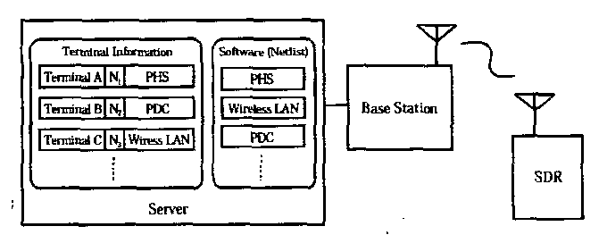
Secure Software Download in SDR
Download Model in SDR

Slide 13
Secure Software Download in SDR
Verification of integrity
Must be a method of ensuring that the software downloaded is intact and has not been modified
Authentication
It has obtained government approval
Furthermore
In the event that some illegally modified software is created, there should be some mechanism to prevent the spread of that illegal software.
For the introduction of a software downloadable SDR system, the software should be protected against theft by people or companies who would like to know the details of the software employed by a rival company

Slide 14
Secure Software Download in SDR
Secret key encryption
Public key encryption
A technique for cryptographic hashing
A technique for cryptographic signature

Slide 15
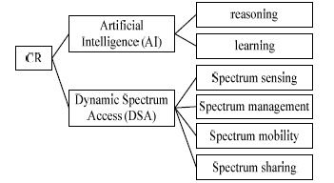
Security in Cognitive Radio
Characteristics of cognitive radio

Slide 16
Security in Cognitive Radio
Security threats in CR
Artificial intelligence behavior threats
Policy threats
Learning threats
Parameters threats

Slide 17
Security in Cognitive Radio
Security threats in CR
Dynamic spectrum access threats
Spectrum sensing threats
Spectrum management threats
Spectrum mobility threats

Slide 18
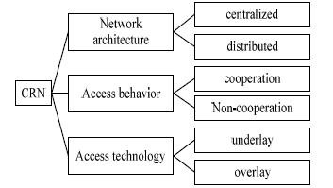
Security Threats in Cognitive Radio Networks
Characteristics of cognitive radio network

Slide 19
Security Threats in Cognitive Radio Networks
threats to a cognitive radio network
sensory input statistics can be altered
faulty sensory input statistics can lead to belief manipulation
manipulated individual statistics and beliefs may be distributed through a cognitive radio network
behavior algorithms based on manipulated statistics and beliefs can result in suboptimal performance or maliciousbehavior

Slide 20
Security Threats in Cognitive Radio Networks
To mitigate the effectiveness of previous attacks, cognitive radios should:
always assume sensory input statistics are “noisy” and
subject to manipulation;
be programmed with some amount of “common sense”
to attempt to validate learned beliefs;
compare and validate learned beliefs with other devices
on the network;
expire learned beliefs to prevent long-term effects of
attackers
attempt to perform learning in known-good environments

Slide 21
FUTURE RESEARCH
Understanding Identity
Earning and Using Trust
Trust in Networking and Routing

Slide 22
Thanks For Your Attention

