Slide 1
Department of electrical and computer engineering
An Equalization Technique for High Rate OFDM Systems
Mehdi Basiri

Slide 2
Introduction:
In a typical OFDM system, a guard interval using cyclic prefix is inserted to avoid the ISI & ICI.
The cyclic prefix is the insertion of the last N_{g} samples to the original sample sequence, where N_{g} is the length of the guard interval.

Slide 3
Introduction(cont.) :
This method is very simple, but it reduces the transmission efficiency.
The reduction factor is :
where N is the number of the sub-carriers.

Slide 4
Introduction(cont.) :
The solution is a time domain equalizer (TEQ)
in cascade with the original channel to shorten the effective channel impulse response to be in the range of the guard interval.
Many TEQ algorithms have been proposed based on different optimum criteria.
However for the 54Mbps IEEE 802.11a OFDM system, most of the popular TEQ algorithms are not suitable.

Slide 5
Introduction(cont.) :
This paper :
propose a time domain equalization technique for the high rate IEEE 802.11a OFDM system, which has a comparatively reduced computational complexity for a practical use.

Slide 6
System model:
Sequence of X (k) is the modulated data of the sub-carriers

Slide 7
System model(cont.):

Slide 8
System model(cont.):

Slide 9
TEQ Algorithms:
The main approaches is :

Slide 10
TEQ Algorithms:

Slide 11
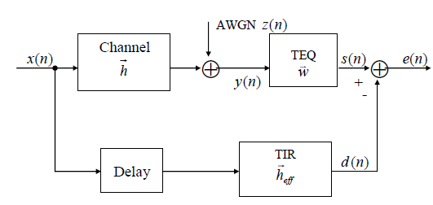
A. Minimum Mean Square Error (MMSE) Algorithm

Slide 12
B. Maximum Shortening Signal to Noise Ratio (MSSNR) Algorithm

Slide 13
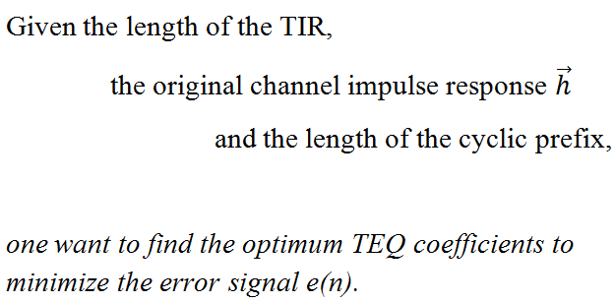
Proposed TEQ Algorithm

Slide 14
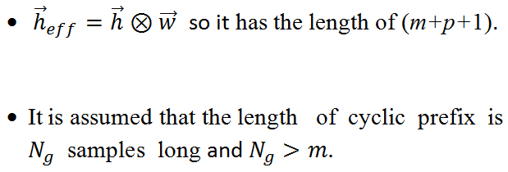
Proposed TEQ Algorithm(cont.)

Slide 15
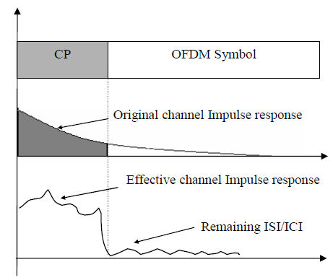
Proposed TEQ Algorithm(cont.)

Slide 16
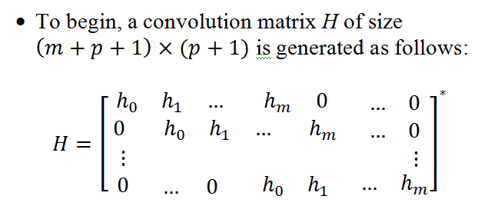
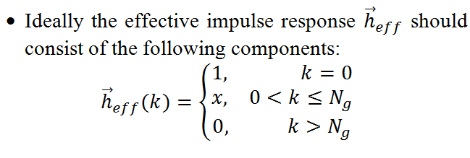
Proposed TEQ Algorithm(cont.)

Slide 17
Proposed TEQ Algorithm(cont.)
so that:

Slide 18
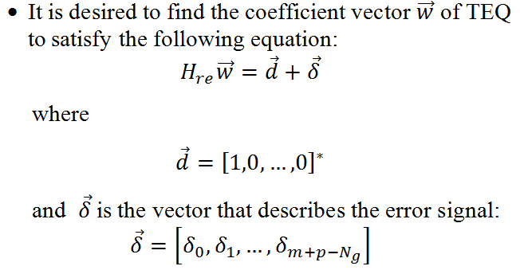
Proposed TEQ Algorithm(cont.)

Slide 19
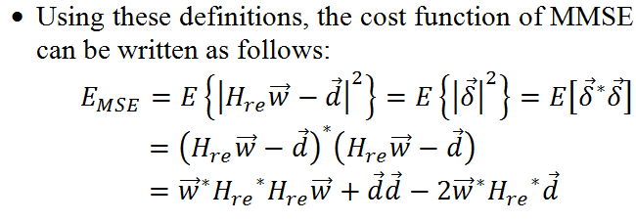
Proposed TEQ Algorithm(cont.)

Slide 20
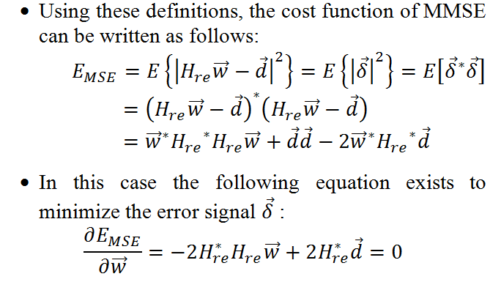
Proposed TEQ Algorithm(cont.)

Slide 21
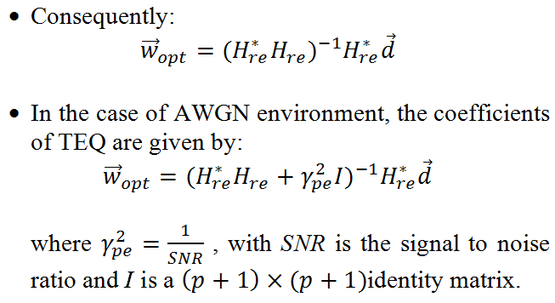
Proposed TEQ Algorithm(cont.)

Slide 22
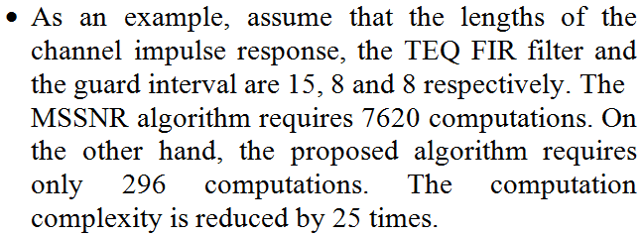
Computational complexity:

Slide 23
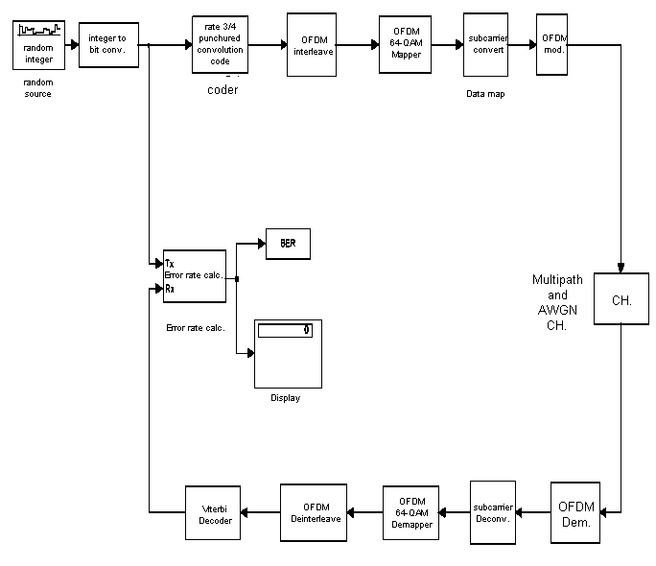
Simulation Results:
System model

Slide 24
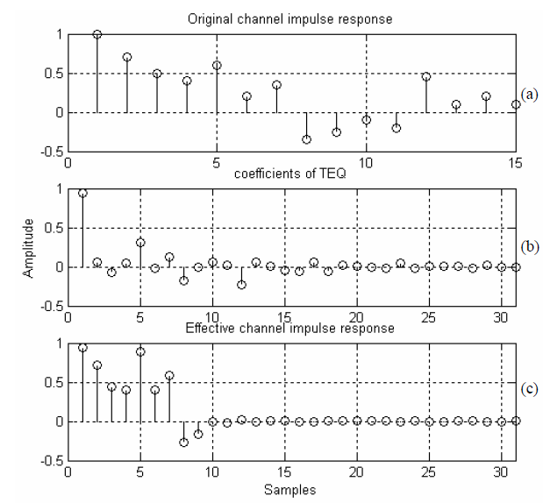
Simulation Results:
Functionality validation of the TEQ

Slide 25
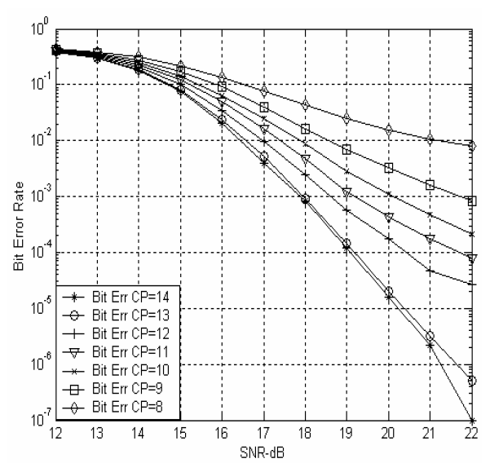
Simulation Results:
System performances with different length of cyclic prefix

Slide 26
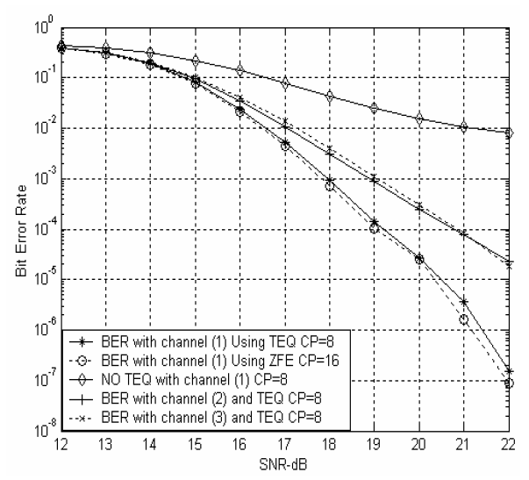
Simulation Results:
Simulation results for system BER performance

Slide 27
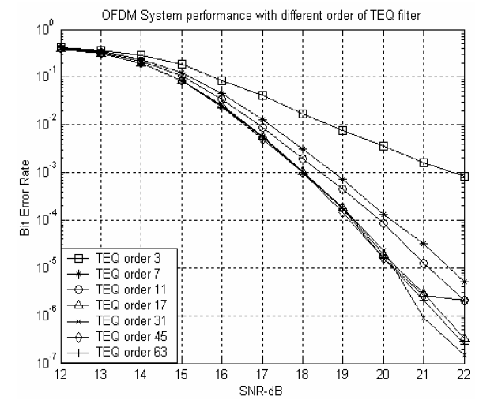
Simulation Results:
Simulation results with different orders of the FIR to implement the TEQ

Slide 28
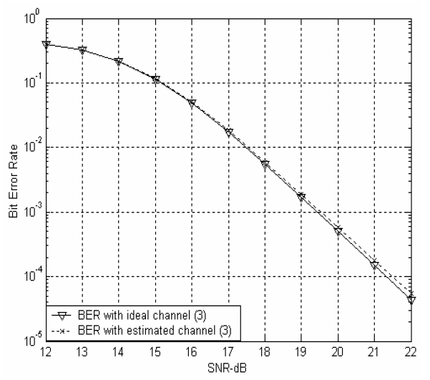
Simulation Results:
Bit error rate with estimated and ideal channels

Slide 29
:Conclusions
The most popular algorithms used to design TEQ (the MMSE, the MSSNR) are discussed in this presentation.
A reduced computational complexity TEQ algorithm is proposed.
Simulation results verify the functionality of the proposed algorithm.

Slide 30
Thanks For Your Attention

